Slide 1
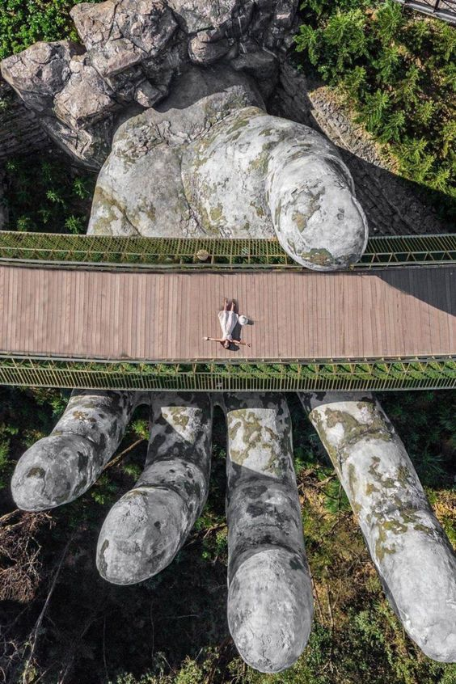
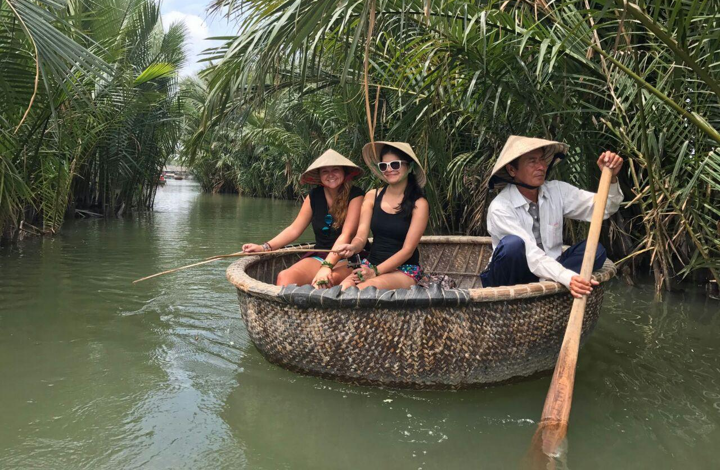
Danang
Bana Hills, Hue, Hoian
Vietnam
Special Arrange: Bamboo Boat Ride
TOUR CODE:-5DAC2- | UPDATED: 19MAR2023

Slide 2
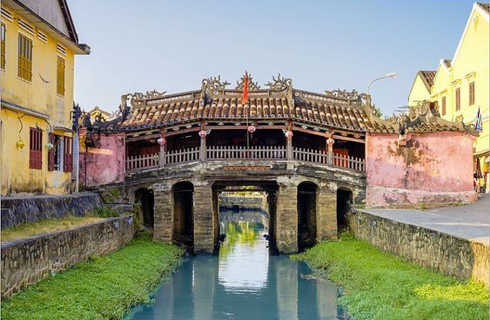
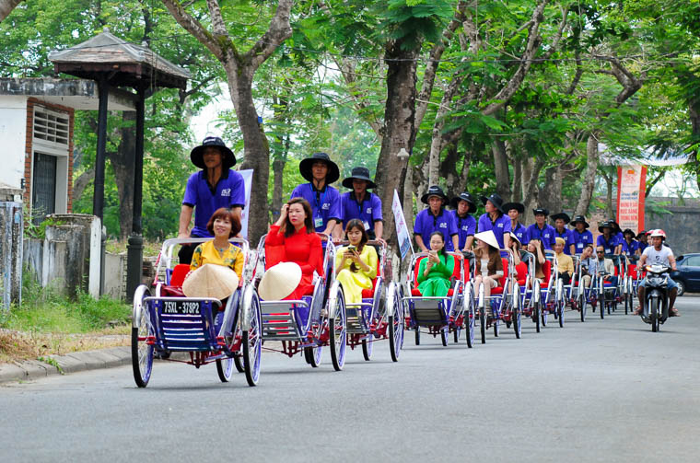
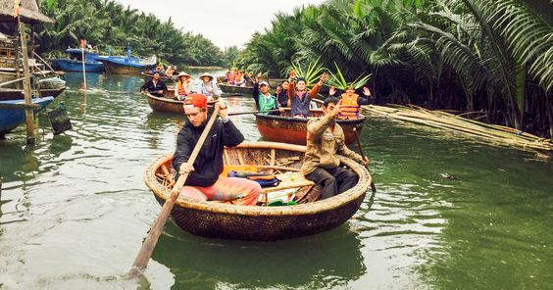
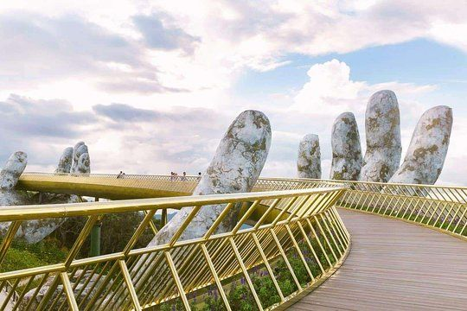
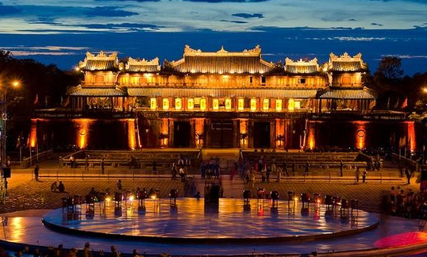
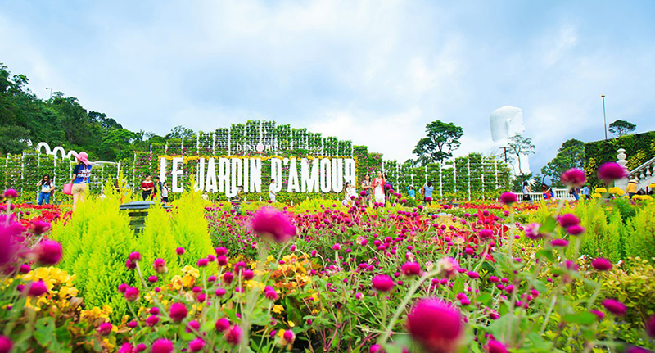
行程亮点 Highlights
Japanese Bridge
日本桥
Impearial Citadel (Included Cyclo Ride)
大内皇城 (人力车游)
Bamboo boat riding at Cam Nam Coconut Village
竹篮船参观迦南叶子林
Golden Hand Bridge
佛手金桥
Royal Citadel
顺化皇城
Le Jardine D’amour
爱情花园

Slide 3
行程简介
第一天
吉隆坡-岘港-顺化 (午/晚）
机场集合办理登记手续，前往岘港
立安潭
天母寺 - 又名灵姥寺已有近400年历史。始建于黎朝弘定二年(公元1601年),系阮氏始祖阮淦次子阮潢所造
东巴市场
顺化香江传统歌唱表演
第二天
顺化-会安 (早/午/晚）
大内皇城(人力车游) - 建于1802年，是统一后的越南的首都。香河蜿蜒流经都城、皇城、紫禁城和内城，给这座独特的封建城市增添了自然美。
会安古城 - 作为一个海港城市迄今已有1500年的历史，是东南亚保存较完好的传统贸易港。1999年联合国教科文组织将其列入世界文化遗产名录
第三天
会安-岘港 （早/午/晚）
迦南岛渔村（含簸箕船）- 乘坐独一无二的簸箕船游迦南岛渔村，以及体验当地人特别的垂钓方式。
五行山 - 位于越南岘港市南部，这里因5座沿海屹立的石灰岩石峰而得名。这五座山分别对应阴阳五行，命名为金、木、水、火、土
努尔卡石雕村
婆雕刻品博物馆
第四天
岘港 （早/午/晚）
巴拿山(含缆车) - 海拔1487米，從山腳下可以乘坐纜車到達山頂，相傳能在一天之內感受到四季的獨特感受，巴拿山的纜車長度5801米，巴拿山纜車系統是世界上最常單線纜車的記錄保持者
空中巨手捧桥
法国村 / Fantasy Park
爱情花园
汉市场
灵应寺(白玉观音像)
APEC雕塑园
龙桥(途径)
DHC Marina (爱情桥, 岘港鱼尾狮)
第五天
抵达吉隆坡 （早）
结束美好的旅程

Slide 4
Travel Itinerary
DAY 1
Kuala Lumpur – Danang – Hue (L/D)
Assemble at airport check in, flight to Danang
Lang Co Lagoon
Thien Mu Pagoda – Also known as heavenly lady pagoda, it is one of he oldest ancient architectural structures used for religious worship in Hue
Dong Ba Market
Perfume River Boat Trip with traditional music
DAY 2
Hue - Hoi An (B/L/D)
Impearial Citadel (Included Cyclo Ride) – It has been officially recognized by the UNESCO as a World Heritage in 1993
Hoian Old Town
Phux Kien Assembly Hall, Tna Ky Merchant House, Japanese Bridge
DAY 3
Hoi An – Hue (B/L/D)
Cam Thanh Village (Included Bamboo Boat Ride) – Ride on a bamboo basket boat along Cam Thanh River with the locals and learn about the traditional fishing techniques used in the river
Marble Mountain
Non Nuoc Caving Stone Village
The Cha Musuem (Museum of Cham Sculpture)
DAY 4
Hue – Danang (B/L/D)
Bana Hills (Included cable car) - A colonial French hill station established in 1919, Ba Na Hill is an immense mountain resort catering to local and foreign vacationers alike. Ascend the lush tropical forest from a non-stop cable car, the longest and highest of its kind in the world
Golden Bridge
French Village / Fantasy Park
Le Jardine D’Amour
Han Market
Ling Ung Pagoda (Quan Yin)
APEC Sculpture Park
Dragon Bridge (Pass BY)
DHC Marina (Love Bridge, Dragon Fish Statue)
DAY 5
Arrival Kuala Lumpur (B)
Bye and see your next trip

Slide 5
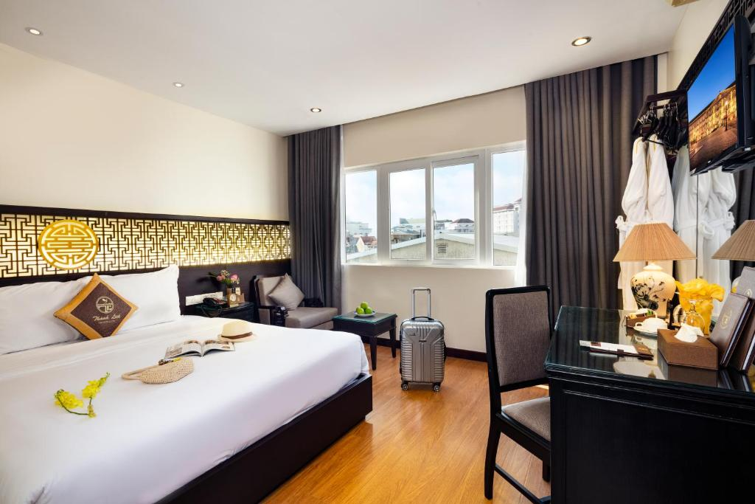
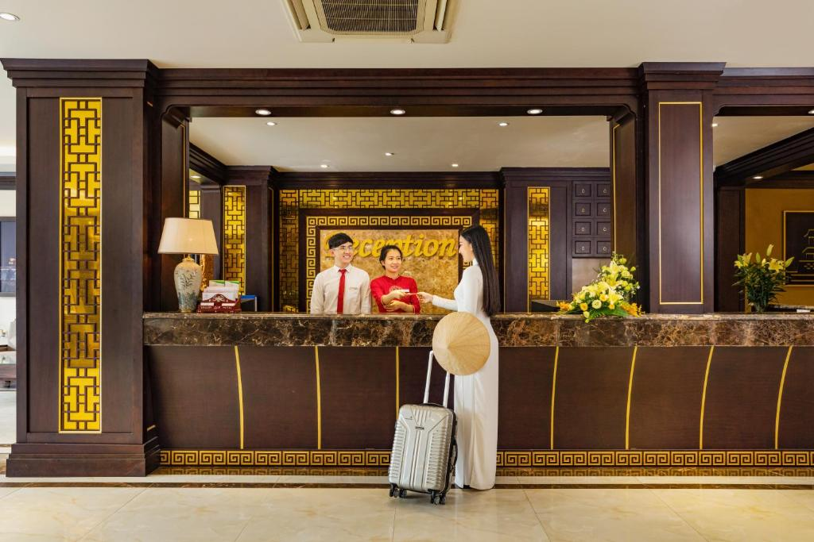
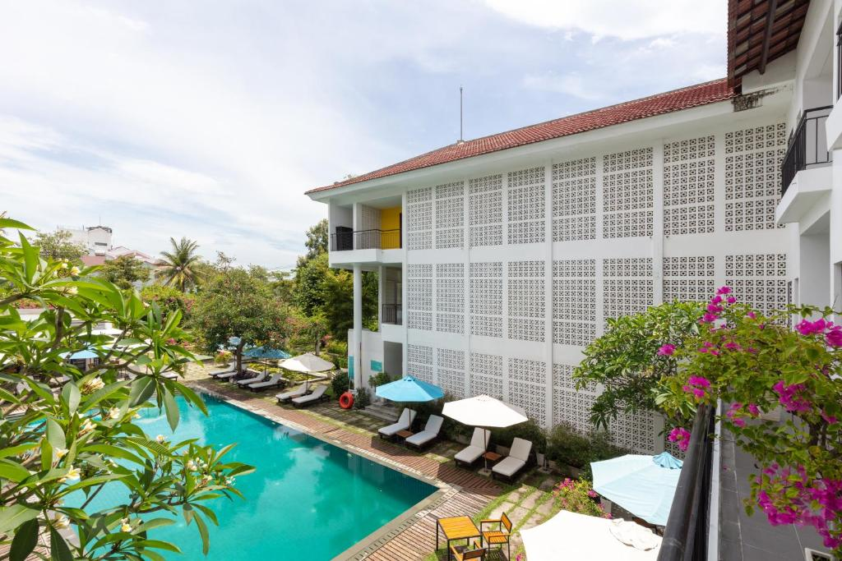
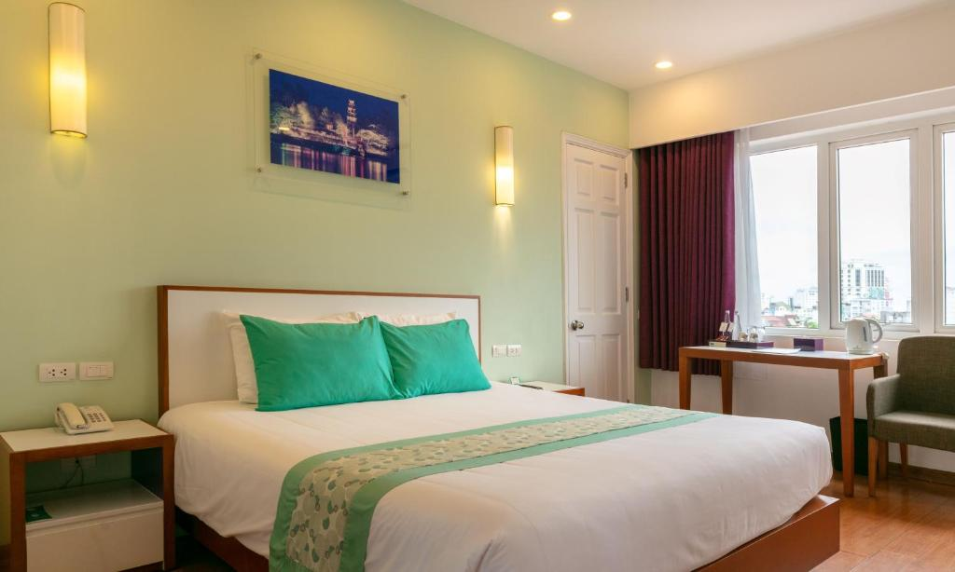
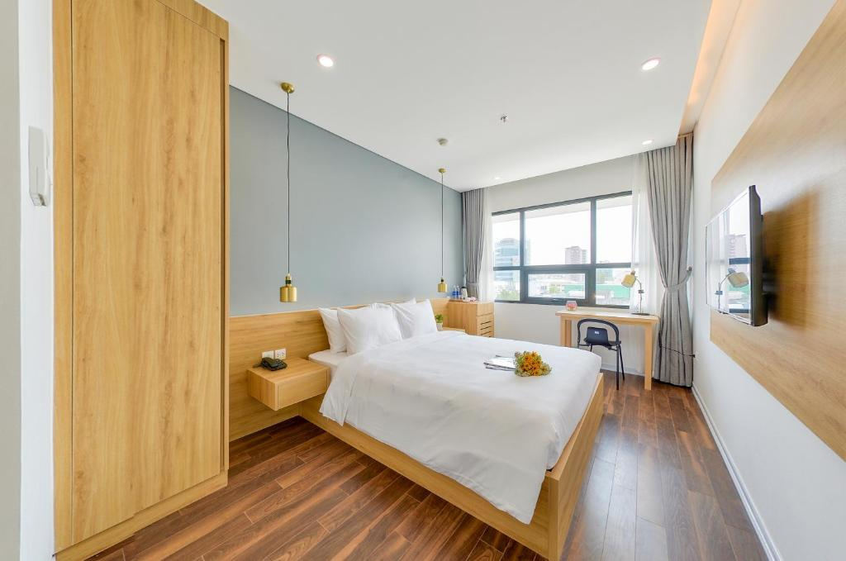
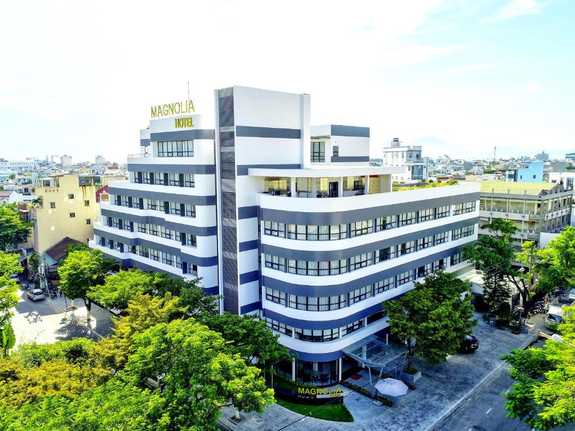
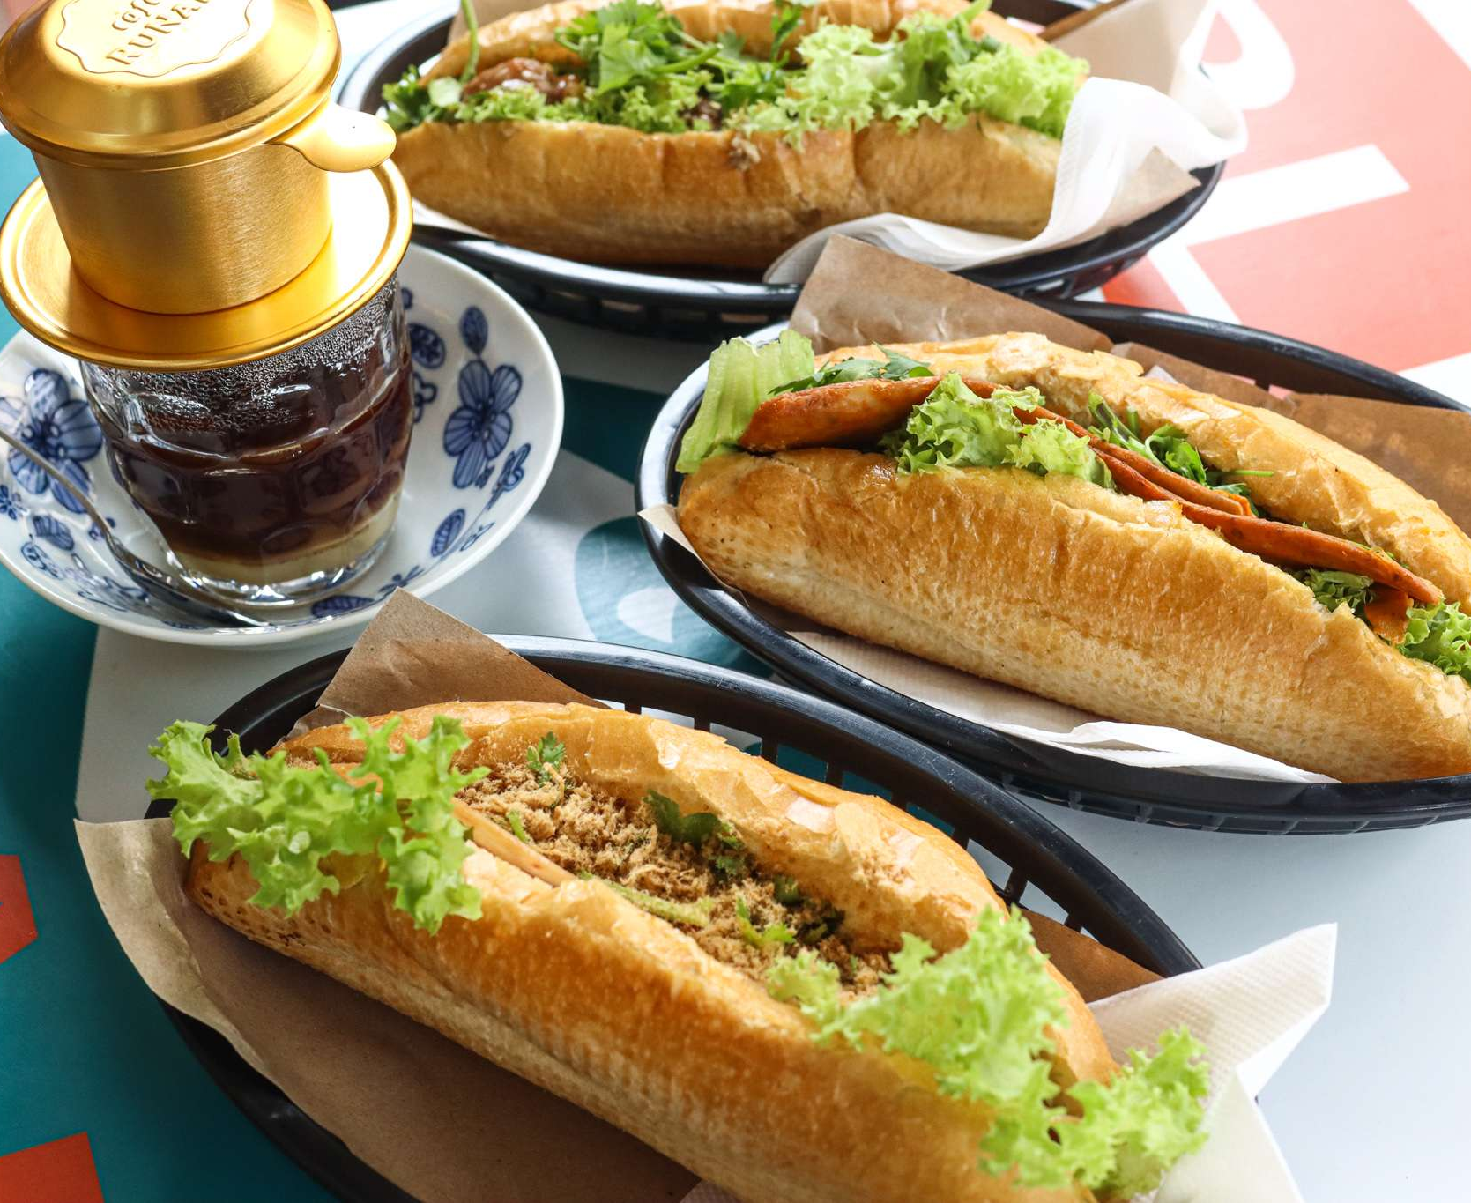
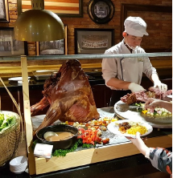
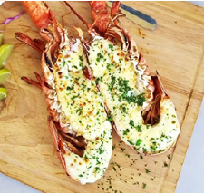
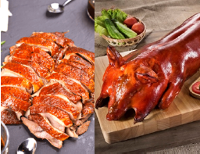
酒店 Hotel 4* Deluxe Hotel
4* Thanh Lich Royal Boutique or similar class
4* Emm Hoian or similar class
4* Magnolia or similar class
5D4N DANANG / HUE / HOIAN / BANA HILLS
Adult 成人 | Child with Bed 小孩加床 | Child without Bed 小孩不加床 | Single Supp 单人房差
Banh My & Vietnamese Coffee
Bana Hill Buffet Lunch
Grilled lobster Menu
Chinses Cuisine (Roasted Duck & Suckling Pig)

Slide 6
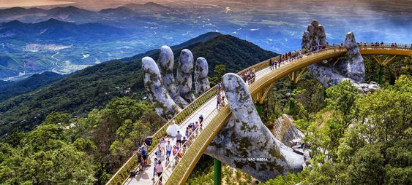
条款与条规
01. 行程表所列出的航班资料，交通，行程，酒店住宿及膳食安排， 将可能因应不同的出发日期而有所变动，恕可 能不及时通知。 若报名后行程有所变动，本社将另行个别通知。
02. 行程，膳食及住宿的先后次序，将以当地接待社和天气情况安排为准。
03. 本公司会根据团量来安排旅游巴士的大小，但若巴士行李舱放置空间不足时，若会遇上行李箱得放置在车厢内的 可能，所以一人一座位为前提。
04. 基本上全程中文讲解为主。 若需要以其他语言讲解，务必在报名时提前通知本社。 本社将另作安排，但将以最 终确认为准。
05. 团队出发前建议购买旅游保险以则安心。
06. 行程表附上的照片仅供参考。
07. 为确保消费者权益，详情请参阅单据背面之基本条规细节。
08. 行程最终将以英文版本为准。
Terms& conditions
01. Flights, transportation, hotels, meals and itinerary stated in the brochure are subject to change without prior notice. Any changes after booking shall be advised accordingly.
02. The sequence of itinerary, meals and hotel arrangements are subject to the final confirmation by the local ground operator due to weather situation.
03. Tour buses are arranged based on group size. Every passenger is entitled to one seat each. Should there be extra seats remaining, it shall be reserved for the baggage storage.
04. Tour is conducted in Mandarin, unless otherwise stated.
05. Purchase of travel insurance is highly advisable.
06. The images shown in tour itinerary are only for indicative.
07. For other conditions, please refer to overleaf of your booking form for our standard terms and conditions.
08. The English version of itinerary shall prevail.

